Slide 2
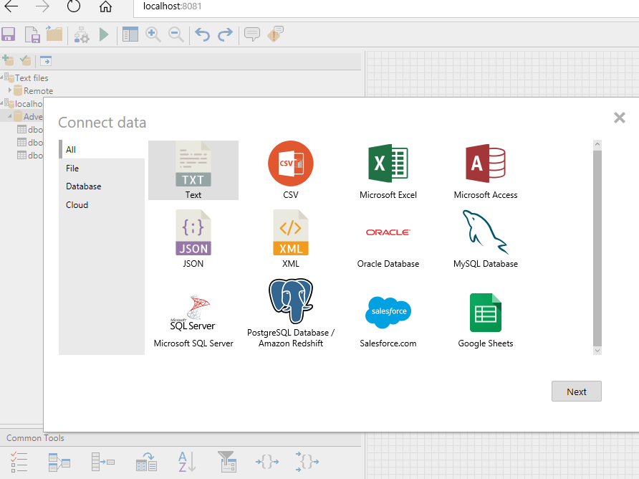
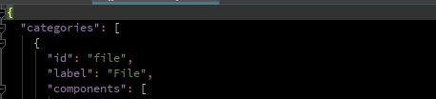
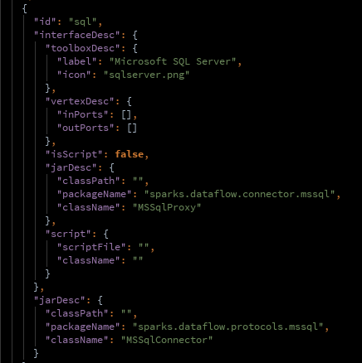
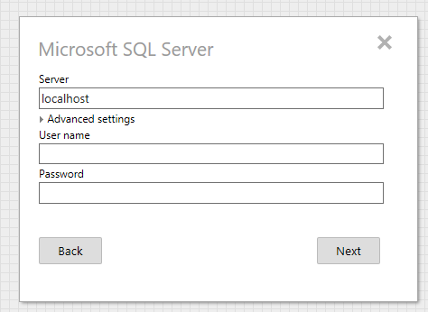
…

Slide 3
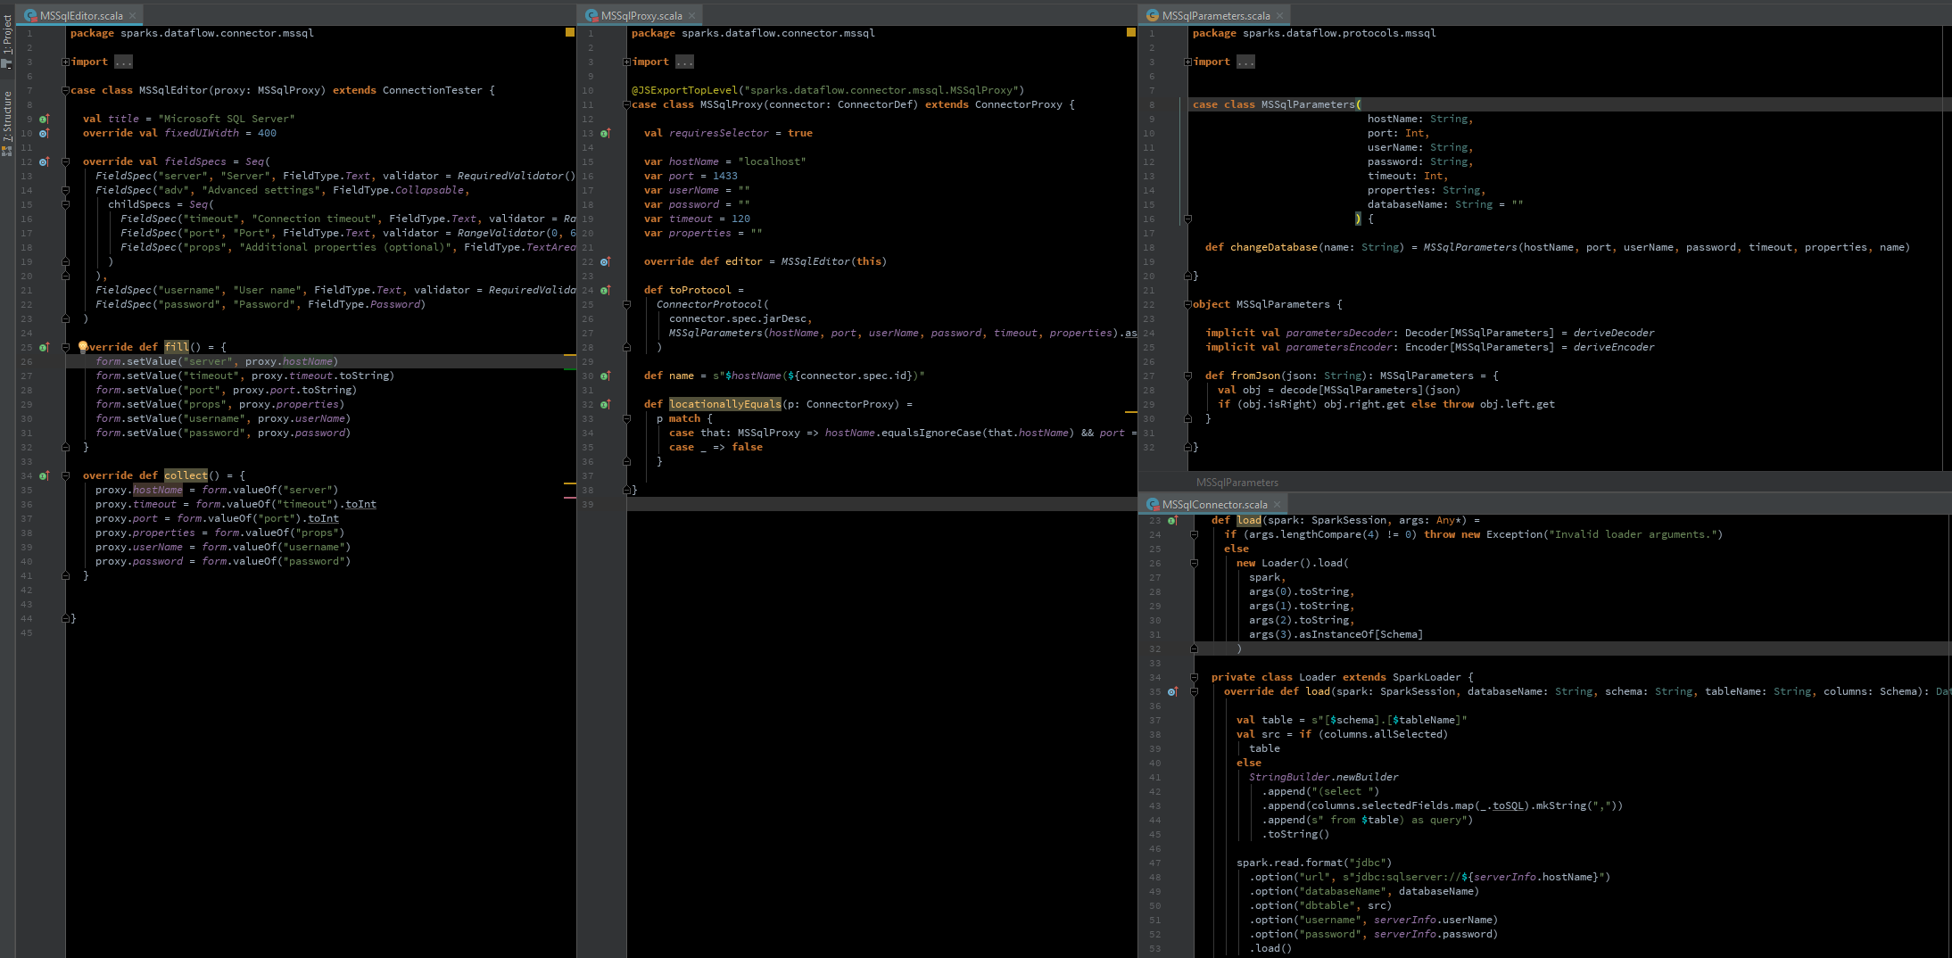

Slide 4
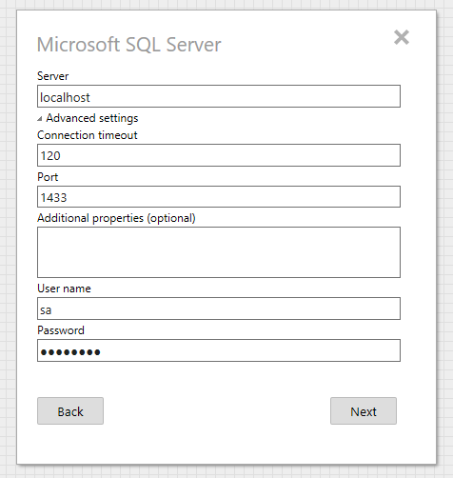
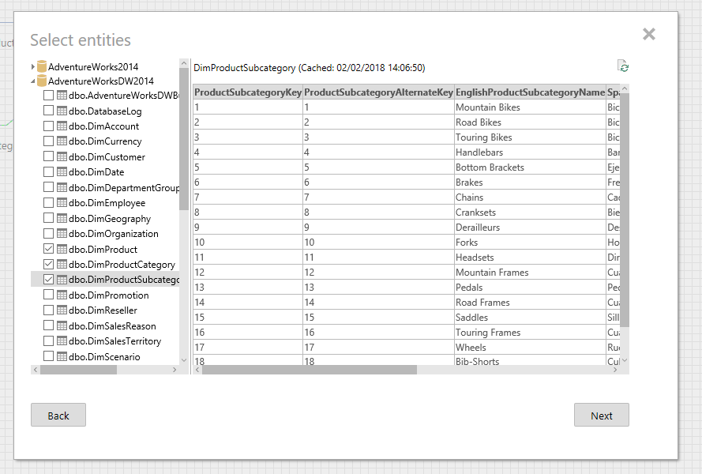
Editor
State in proxy
Connector
{
“hostName”: “localhost”,
“timeout”: 120,
“port”: 1433,
“properties”: “”
“userName”: “sa”
“password”: “********”
}

Slide 5
package sparks.dataflow.connector.mssql import io.circe.syntax._ import sparks.dataflow.connector.{ConnectorDef, ConnectorProxy} import sparks.dataflow.protocols.Connector.ConnectorProtocol import sparks.dataflow.protocols.mssql.MSSqlParameters import scala.scalajs.js.annotation.JSExportTopLevel @JSExportTopLevel("sparks.dataflow.connector.mssql.MSSqlProxy") case class MSSqlProxy(connector: ConnectorDef) extends ConnectorProxy { val requiresSelector = true var hostName = "localhost" var port = 1433 var userName = "" var password = "" var timeout = 120 var properties = "" override def editor = MSSqlEditor(this) def toProtocol = ConnectorProtocol( connector.spec.jarDesc, MSSqlParameters(hostName, port, userName, password, timeout, properties).asJson.noSpaces ) def name = s"$hostName(${connector.spec.id})" def locationallyEquals(p: ConnectorProxy) = p match { case that: MSSqlProxy => hostName.equalsIgnoreCase(that.hostName) && port == that.port case _ => false } }
package sparks.dataflow.connector.mssql import sparks.dataflow.connector.ConnectionTester import sparks.webui.entity.validators.{RangeValidator, RequiredValidator} import sparks.webui.entity.{FieldSpec, FieldType} case class MSSqlEditor(proxy: MSSqlProxy) extends ConnectionTester { val title = "Microsoft SQL Server" override val fixedUIWidth = 400 override val fieldSpecs = Seq( FieldSpec("server", "Server", FieldType.Text, validator = RequiredValidator()), FieldSpec("adv", "Advanced settings", FieldType.Collapsable, childSpecs = Seq( FieldSpec("timeout", "Connection timeout", FieldType.Text, validator = RangeValidator(0, 9999)), FieldSpec("port", "Port", FieldType.Text, validator = RangeValidator(0, 65535)), FieldSpec("props", "Additional properties (optional)", FieldType.TextArea, height = 50) ) ), FieldSpec("username", "User name", FieldType.Text, validator = RequiredValidator()), FieldSpec("password", "Password", FieldType.Password) ) override def fill() = { form.setValue("server", proxy.hostName) form.setValue("timeout", proxy.timeout.toString) form.setValue("port", proxy.port.toString) form.setValue("props", proxy.properties) form.setValue("username", proxy.userName) form.setValue("password", proxy.password) } override def collect() = { proxy.hostName = form.valueOf("server") proxy.timeout = form.valueOf("timeout").toInt proxy.port = form.valueOf("port").toInt proxy.properties = form.valueOf("props") proxy.userName = form.valueOf("username") proxy.password = form.valueOf("password") } }
{
“hostName”: “localhost”,
“timeout”: 120,
“port”: 1433,
“properties”: “”
“userName”: “sa”
“password”: “********”
}
edits
case class MSSqlParameters( hostName: String, port: Int, userName: String, password: String, timeout: Int, properties: String, databaseName: String = "" ) { def changeDatabase(name: String) = MSSqlParameters(hostName, port, userName, password, timeout, properties, name) } object MSSqlParameters { implicit val parametersDecoder: Decoder[MSSqlParameters] = deriveDecoder implicit val parametersEncoder: Encoder[MSSqlParameters] = deriveEncoder def fromJson(json: String): MSSqlParameters = { val obj = decode[MSSqlParameters](json) if (obj.isRight) obj.right.get else throw obj.left.get } }

Slide 6
package sparks.dataflow.protocols import org.apache.spark.sql.{DataFrame, SparkSession} import sparks.dataflow.protocols.Auxiliaries.{DbEntity, Field, Schema} import scala.io.Source trait BaseConnector { def getCacheKey(catalog: String, table: String): String def init(context: String): BaseConnector def testConnection(): String def listDatabases(): Array[String] def listTables(databaseName: String): Array[DbEntity] def listColumns(databaseName: String, schema: String, tableName: String): Array[Field] def previewTable(databaseName: String, tableName: String): String def load(spark: SparkSession, args: Any*): DataFrame trait SparkLoader { def load(spark: SparkSession, databaseName: String, schema: String, tableName: String, columns: Schema): DataFrame = ??? def loadRemoteFile(spark: SparkSession, fileName: String): DataFrame = { import spark.implicits._ spark .sparkContext .parallelize(Source.fromURL(fileName).mkString.split("\n").filter(_.nonEmpty)) .toDF() } def loadLocalFile(fileName: String): DataFrame = ??? } }
supports
TableSelector
supports
data loading in Spark

Slide 7
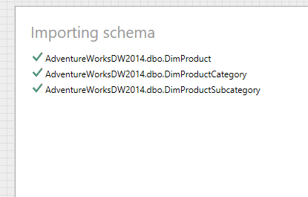
case class MSSqlParameters( hostName: String, port: Int, userName: String, password: String, timeout: Int, properties: String, databaseName: String = "" ) { def changeDatabase(name: String) = MSSqlParameters(hostName, port, userName, password, timeout, properties, name) }
package sparks.dataflow.protocols import org.apache.spark.sql.{DataFrame, SparkSession} import sparks.dataflow.protocols.Auxiliaries.{DbEntity, Field, Schema} import scala.io.Source trait BaseConnector { def getCacheKey(catalog: String, table: String): String def init(context: String): BaseConnector def testConnection(): String def listDatabases(): Array[String] def listTables(databaseName: String): Array[DbEntity] def listColumns(databaseName: String, schema: String, tableName: String): Array[Field] def previewTable(databaseName: String, tableName: String): String def load(spark: SparkSession, args: Any*): DataFrame trait SparkLoader { def load(spark: SparkSession, databaseName: String, schema: String, tableName: String, columns: Schema): DataFrame = ??? def loadRemoteFile(spark: SparkSession, fileName: String): DataFrame = { import spark.implicits._ spark .sparkContext .parallelize(Source.fromURL(fileName).mkString.split("\n").filter(_.nonEmpty)) .toDF() } def loadLocalFile(fileName: String): DataFrame = ??? } }

Slide 8
class MSSqlConnector extends DatabaseConnector { implicit class FieldExtension(f: Field) { def toSQL = if (f.alias.isEmpty && f.newType.isEmpty) s"[${f.name}]" else if (f.alias.nonEmpty) s"[${f.name}] as [${f.alias}]" else s"[${f.name}]" // todo: Temp }
… Spark loading implementation (SparkLoader) …
… var serverInfo: MSSqlParameters = _ def init(context: String) = { serverInfo = MSSqlParameters.fromJson(context) this } def getCacheKey(catalog: String, table: String) = s"${serverInfo.hostName}.${serverInfo.userName}.$catalog.$table" def connectionUrl = { val db = if (serverInfo.databaseName.nonEmpty) s"databaseName=${serverInfo.databaseName}" else "" s"jdbc:sqlserver://${serverInfo.hostName}:${serverInfo.port};user=${serverInfo.userName};password=${serverInfo.password};$db" } def getConnection: Connection = { Class.forName("com.microsoft.sqlserver.jdbc.SQLServerDriver") DriverManager.getConnection(connectionUrl) } def listDatabases(): Array[String] = { var cn: Connection = null var rs: ResultSet = null val databases = new ListBuffer[String]() try { cn = getConnection rs = cn.getMetaData.getCatalogs while(rs.next()) { databases += rs.getString("TABLE_CAT") } databases.toArray } finally { closeResultSet(cn, rs) } } def listTables(databaseName: String): Array[DbEntity] = { var cn: Connection = null var rs: ResultSet = null val tables = new ListBuffer[DbEntity]() try { cn = getConnection rs = cn.getMetaData.getTables(databaseName, null, null, Array("TABLE")) while(rs.next()) { val schema = rs.getString("TABLE_SCHEM") val name = rs.getString("TABLE_NAME") tables += DbEntity(databaseName, schema, name, "[%s].[%s]".format(schema, name), EntityType.parse(rs.getString("TABLE_TYPE")) ) } tables.toArray } finally { closeResultSet(cn, rs) } }
// todo: Temp implementation private val typeMap = Map( "int" -> "Int", "smallint" -> "Int", "int identity" -> "Int", "nchar" -> "String", "nvarchar" -> "String", "bit" -> "Boolean", "varbinary" -> "Binary", "datetime" -> "Date", "datetime2" -> "Date", "float" -> "Float", "money" -> "BigDecimal", "decimal" -> "BigDecimal" ) def listColumns(databaseName: String, schema: String, tableName: String): Array[Field] = { var cn: Connection = null var rs: ResultSet = null val columns = new ListBuffer[Field]() try { cn = getConnection rs = cn.getMetaData.getColumns(databaseName, schema, tableName, null) while(rs.next()) { val typeName = rs.getString("TYPE_NAME") columns += Field( name = rs.getString("COLUMN_NAME"), dataType = if (typeMap.contains(typeName)) typeMap(typeName) else typeName, nullable = rs.getInt("NULLABLE") == ResultSetMetaData.columnNullable ) } columns.toArray } finally { closeResultSet(cn, rs) } } def previewTable(databaseName: String, tableName: String): String = { serverInfo = serverInfo.changeDatabase(databaseName) var cn: Connection = null var rs: ResultSet = null try { cn = getConnection val stmt = cn.createStatement() rs = stmt.executeQuery(getPreviewTableSql(tableName)) serializePreview(rs) } finally { closeResultSet(cn, rs) } } def getPreviewTableSql(tableName: String): String = "select top 20 * from %s".format(tableName)
}

Slide 9
